Slide 1
PROTECT YOUR SHEEP
Notes:
Let’s learn about ways to protect your sheep.
For more biosecurity resources, visit www.cfsph.iastate.edu/biosecurity

Slide 2
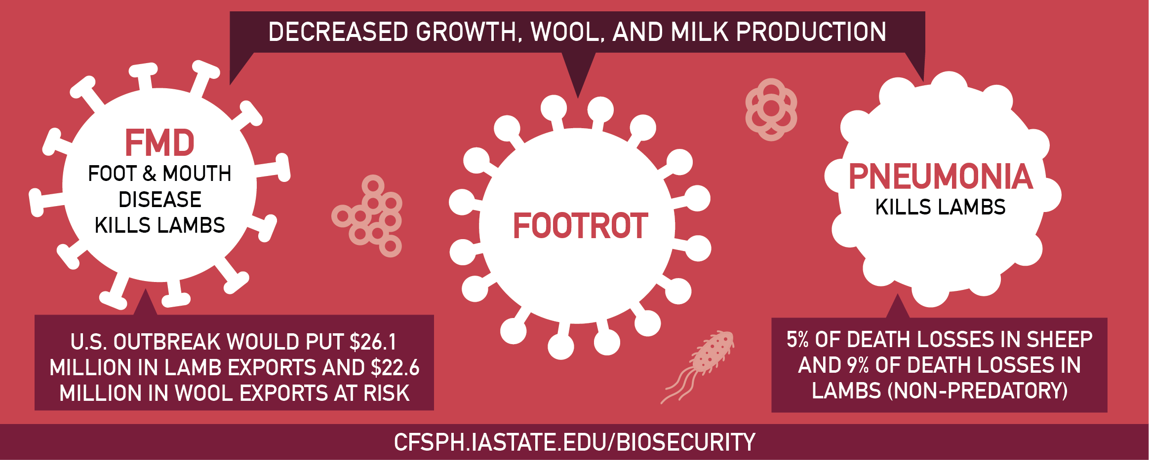
Diseases Harm Animal Health
Diseases are Costly
Notes:
Common and foreign animal diseases harm animal health and are costly. FMD, or Foot and Mouth Disease, footrot, and pneumonia cause decreased growth, decreased wool and milk production. If the U.S. were to have an outbreak of Foot and Mouth Disease, or FMD, a foreign animal disease, not only would it kill lambs but it would also put $26.1 million in lamb exports and $2.6 million in wool exports at risk. Pneumonia, a more common disease, causes 5% of death losses in sheep and 9% of non-predatory death losses in lambs.

Slide 3
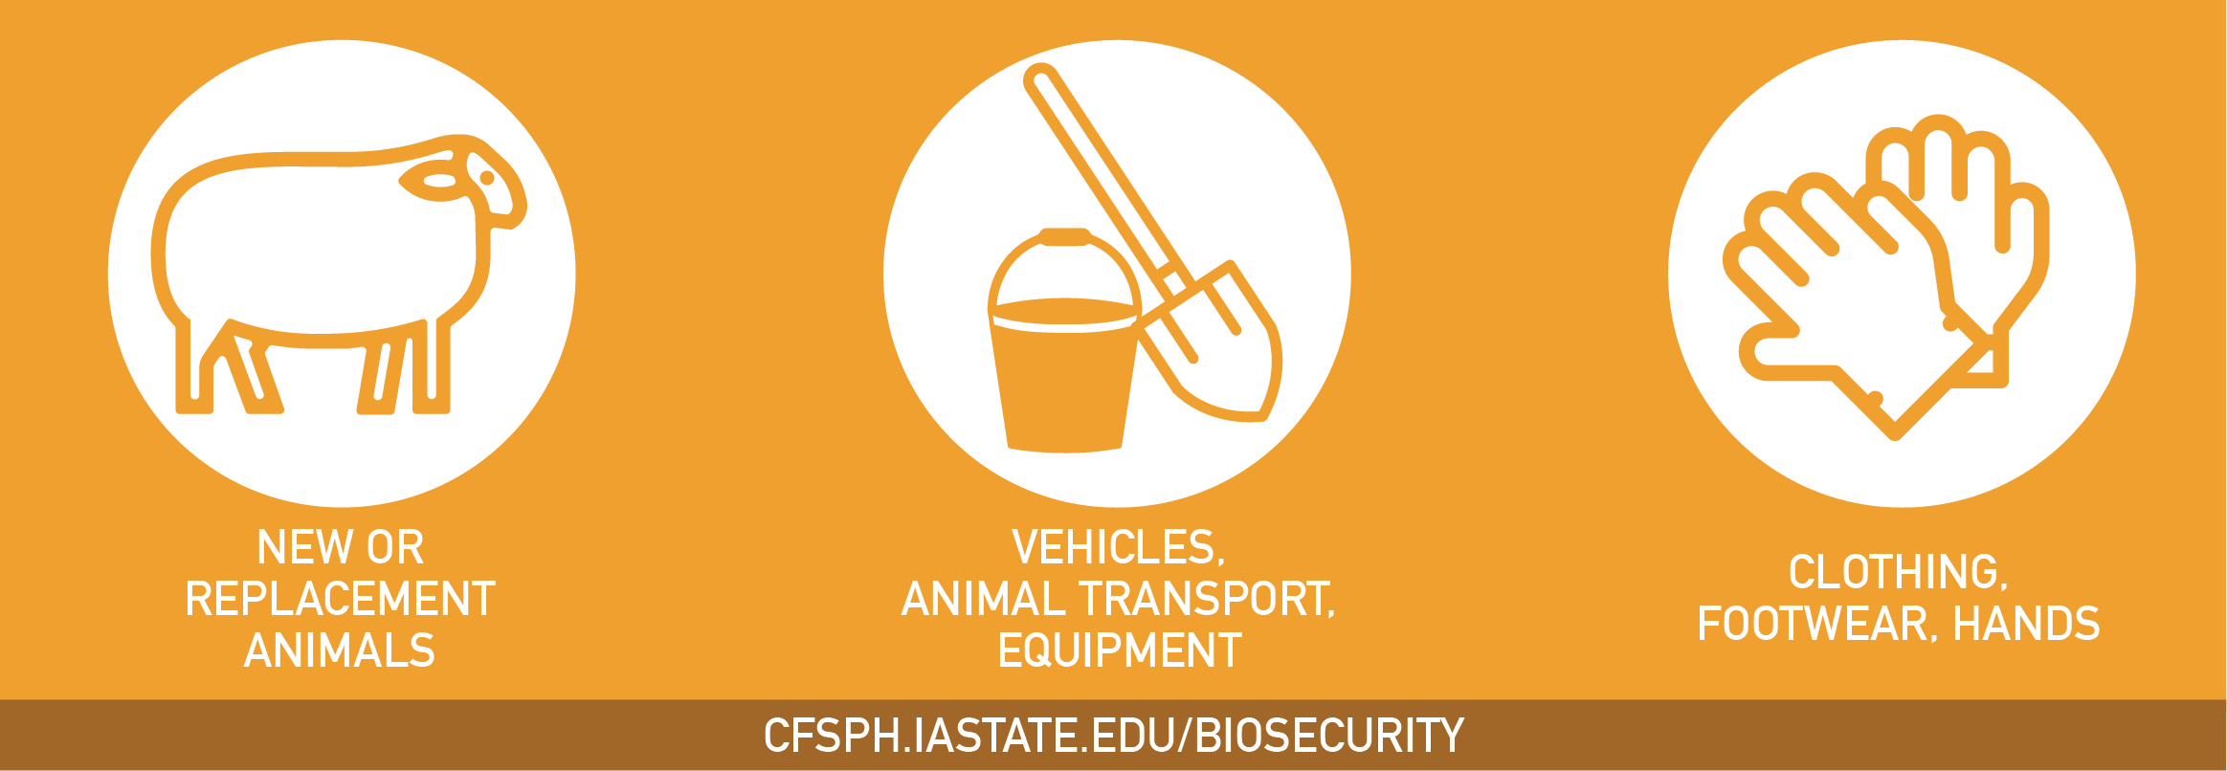
Diseases are Spread By…
Notes:
FMD, footrot, pneumonia, and many others diseases, are spread by adding new or replacement animals to a flock, contaminated vehicles, animal transport, equipment, clothing, footwear and hands that contact animals.

Slide 4

Take Steps Today to Keep Diseases Out!
Protect Your Flock
Notes:
Take steps today to keep diseases out and protect your flock by having a biosecurity plan in place and enforcing it, separate new animals and sick animals from the home flock, limit people access to your animals to only those with clean clothing, footwear and hands. Also, make sure animal pens are kept clean as well as equipment and vehicles used with animals or in their areas. For more information on biosecurity, visit www.cfsph.iastate.edu.

Slide 5
Acknowledgements
Development of this material was made possible through a grant provided to the CFSPH, ISU, CVM from the USDA Animal and Plant Health Inspection Service through the NADPRP. ISU is an equal opportunity provider. For the full non-discrimination statement or accommodation inquiries, go to www.extension.iastate.edu/diversity/ext.
Notes:
Development of this material was made possible through a grant provided to the Center for Food Security and Public Health at Iowa State University, College of Veterinary Medicine from the U.S. Department of Agriculture (USDA) Animal and Plant Health Inspection Service through the National Animal Disease Preparedness and Response Program (NADPRP). Iowa State University is an equal opportunity provider. For the full non-discrimination statement or accommodation inquiries, go to www.extension.iastate.edu/diversity/ext.

