Slide 1
PROTECT YOUR POULTRY
Notes:
Let’s learn about ways to protect your poultry.
For more biosecurity resources, visit www.cfsph.iastate.edu/biosecurity

Slide 2
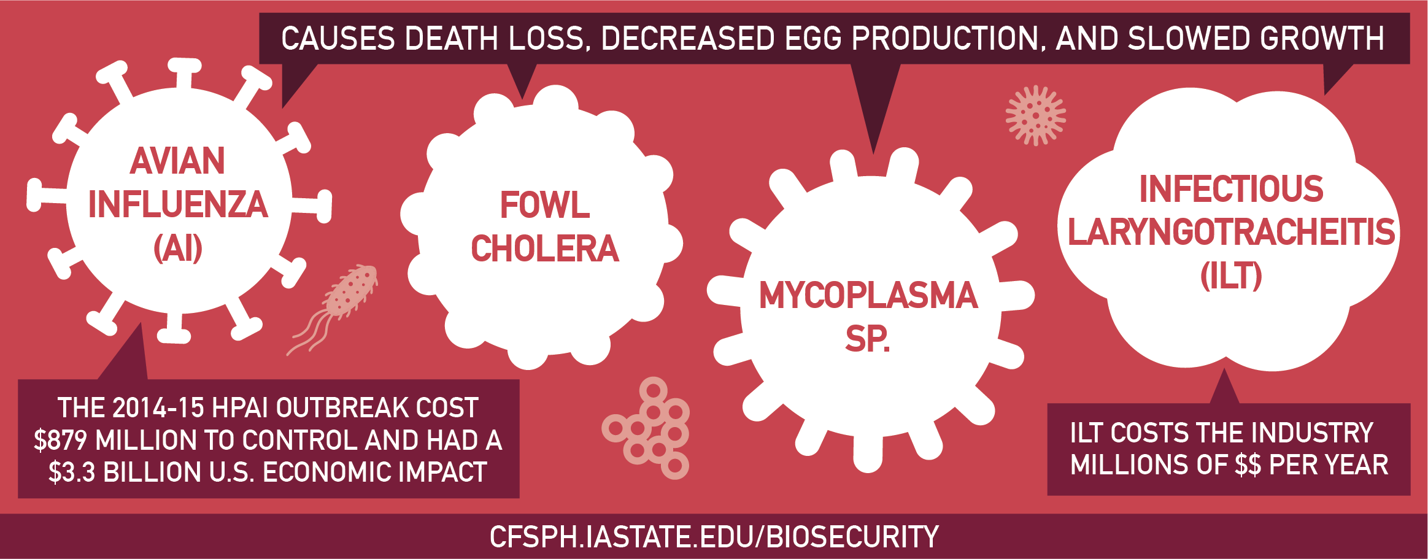
Diseases Harm Animal Health
Diseases are Costly
Notes:
Common and foreign animal diseases harm animal health and are costly. Avian Influenza, or AI, Fowl Cholera, Mycoplasma species, and Infectious Laryngotracheitis, or ILT, cause death loss, decreased egg production, and slowed growth. In the 2014-15 Highly Pathogenic Avian Influenza (HPAI) outbreak, a foreign animal disease that killed millions of poultry, cost $879 million to control and had a $3.3 billion U.S. economic impact. Infectious Laryngotracheitis, a common disease, costs the industry millions of dollars per year.

Slide 3
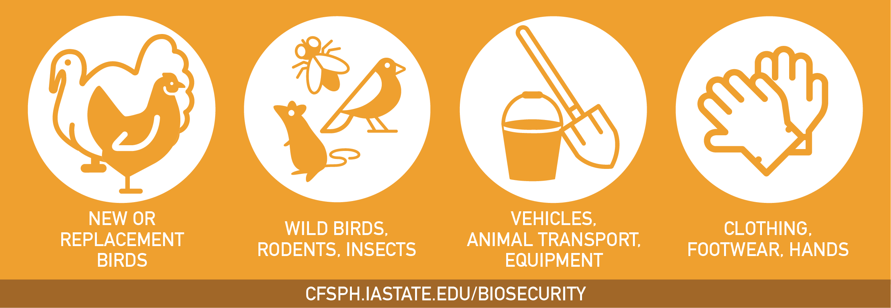
Diseases are Spread By…
Notes:
AI, Fowl Cholera, ILT, and many others, are spread by new or replacement birds, wild birds, rodents, or insects. Poultry diseases are also spread by contaminated vehicles, animal transport, equipment, clothing, footwear, and hands.

Slide 4

Take Steps Today to Keep Diseases Out!
Protect Your Flock
Notes:
Take steps today to keep diseases out and protect your flock by having a biosecurity plan in place and enforcing it, separate new animals and sick animals from the home flock, limit people access to your birds to only those with clean clothing, footwear and hands. Also, make sure animal pens are kept clean as well as equipment and vehicles used with birds or in their areas. For more information on biosecurity, visit www.cfsph.iastate.edu.

Slide 5
Acknowledgements
Development of this material was made possible through a grant provided to the CFSPH, ISU, CVM from the USDA Animal and Plant Health Inspection Service through the NADPRP. ISU is an equal opportunity provider. For the full non-discrimination statement or accommodation inquiries, go to www.extension.iastate.edu/diversity/ext.
Notes:
Development of this material was made possible through a grant provided to the Center for Food Security and Public Health at Iowa State University, College of Veterinary Medicine from the U.S. Department of Agriculture (USDA) Animal and Plant Health Inspection Service through the National Animal Disease Preparedness and Response Program (NADPRP). Iowa State University is an equal opportunity provider. For the full non-discrimination statement or accommodation inquiries, go to www.extension.iastate.edu/diversity/ext.

