Slide 1
PROTECT YOUR PIGS
Notes:
Let’s learn about ways to protect your pigs.
For more biosecurity resources, visit www.cfsph.iastate.edu/biosecurity

Slide 2
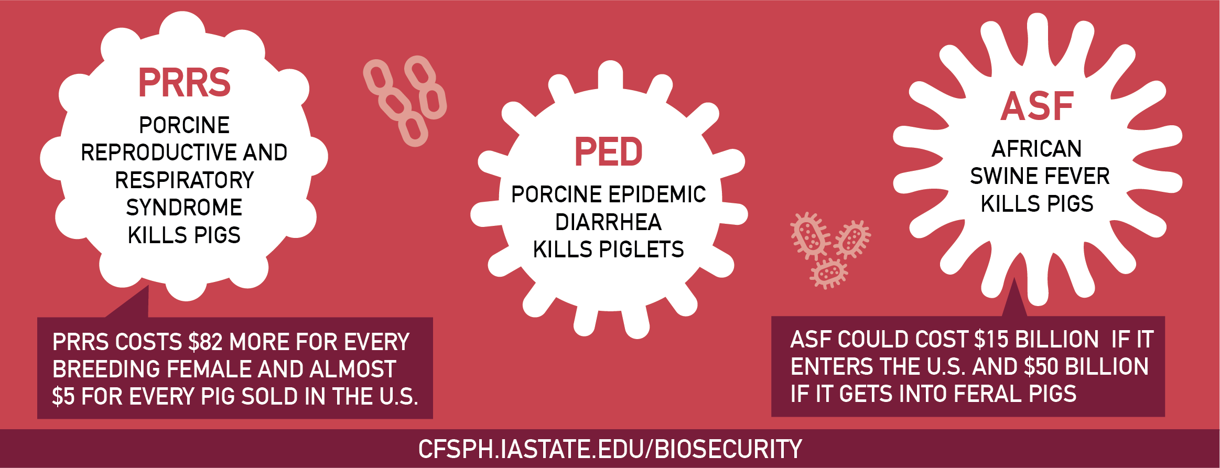
Diseases Harm Animal Health
Diseases are Costly
Notes:
Common and foreign animal diseases harm animal health and are costly. Take PRRS for instance. Not only does it kill pigs, it costs $82 more for every breeding female and almost $5 for every pig sold in the United States. PED or Porcine Epidemic Diarrhea kills piglets. ASF, or African Swine Fever, a foreign animal disease, also kills pigs and could cost $15 billion dollars if it enters the United States and $50 billion dollars if it gets into feral pigs.

Slide 3
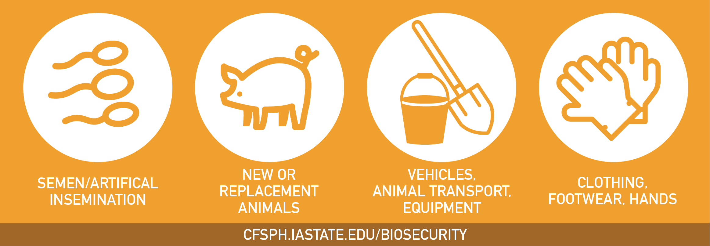
Diseases are Spread By…
Notes:
PRRS, PED, and ASF, and many others, are spread by semen and artificial insemination if the boar carries the disease, adding new or replacement animals to a herd, contaminated vehicles, animal transport, equipment, footwear and hands that contact animals.

Slide 4

Take Steps Today to Keep Diseases Out!
Protect Your Herd
Notes:
Take steps today to keep diseases out and protect your herd by having a biosecurity plan in place and enforcing it, separate new animals and sick animals from the home herd, limit people access to your animals to only those with clean clothing, footwear and hands. Also, make sure animal pens are kept clean as well as equipment and vehicles used with animals or in their areas. For more information on biosecurity, visit www.cfsph.iastate.edu.

Slide 5
Acknowledgements
Development of this material was made possible through a grant provided to the CFSPH, ISU, CVM from the USDA Animal and Plant Health Inspection Service through the NADPRP. ISU is an equal opportunity provider. For the full non-discrimination statement or accommodation inquiries, go to www.extension.iastate.edu/diversity/ext.
Notes:
Development of this material was made possible through a grant provided to the Center for Food Security and Public Health at Iowa State University, College of Veterinary Medicine from the U.S. Department of Agriculture (USDA) Animal and Plant Health Inspection Service through the National Animal Disease Preparedness and Response Program (NADPRP). Iowa State University is an equal opportunity provider. For the full non-discrimination statement or accommodation inquiries, go to www.extension.iastate.edu/diversity/ext.

